Slide 1
ECE 497 · UNIT 3
Two ways to find
a network's weights
Part 1 Backpropagation on XOR
Part 2 Evolving neural networks
Part 3 The same, with PyTorch and EvoTorch
PythonBasics/Unit3/Part1 · Part2 · Part3
Notes:
Both parts solve the same kind of problem: a small network has to label points in 2D. What differs is how we find the numbers inside the network. Part 1 calculates them with gradients; Part 2 searches for them with evolution. Part 3 redoes Part 2 with standard libraries.

Slide 2
OVERVIEW
Same goal, two ways to get there
PART 1 · BACKPROPAGATION
PART 2 · EVOLUTIONARY SEARCH
Calculate which way each weight should move, then step downhill
Treat the parameters as a genome and keep what classifies best
Task: XOR, 4 points
Network: 2 → 10 → 1, sigmoid units
Task: XOR, then a 12-point ring
Network: any shape, 5 activation functions
perceptron.py · train.py
fnn.py · eas.py · evolve.py · compare.py
Notes:
Frame the unit: a neural network is just a function with many knobs (weights and biases). Training means finding knob settings that give the right output for each input. Part 1 uses calculus to decide how to turn each knob. Part 2 never computes a derivative: it tries variations and keeps the good ones.

Slide 3
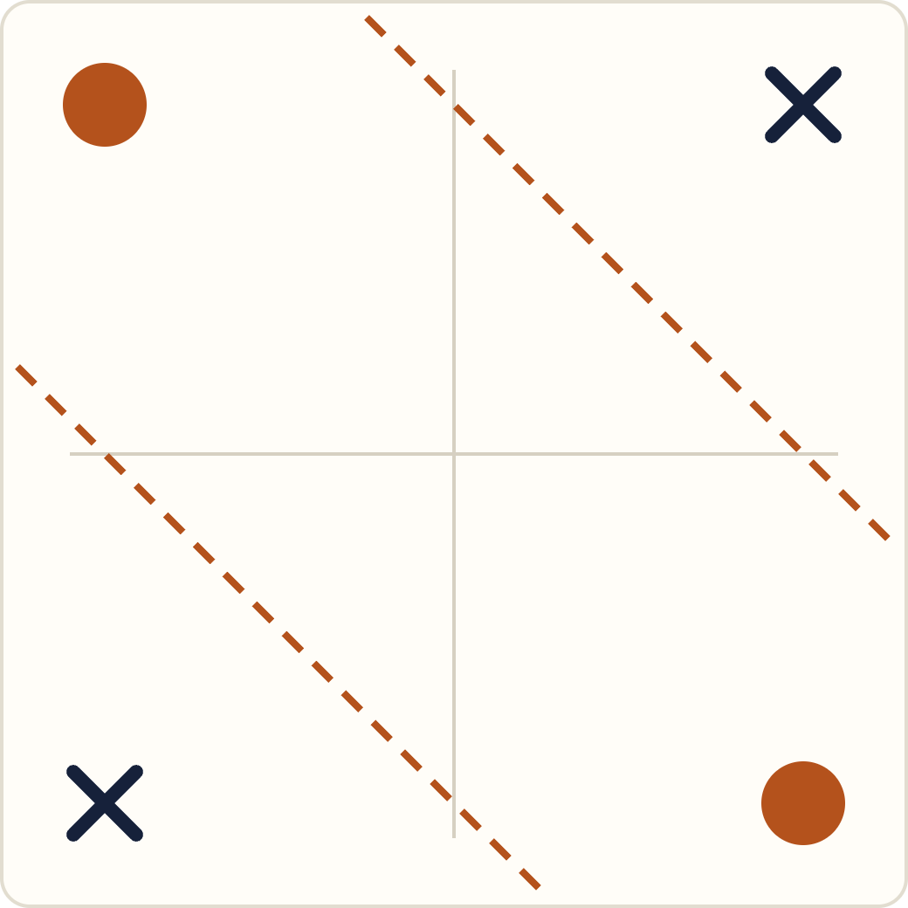
PART 1 · THE TASK
XOR: one line can't separate it
x | y | target
−1 | −1 | 0
−1 | 1 | 1
1 | −1 | 1
1 | 1 | 0
A single sigmoid neuron draws one straight boundary. XOR puts two opposite corners on each side, so we need a hidden layer.
Dots: target 1. Crosses: target 0. Dashed: two lines a hidden layer can combine.
train.py:7–8 · inputs are −1/1, not 0/1
Notes:
Output is 1 when exactly one input is "on". Ask the class to try drawing a single line that separates dots from crosses; they can't. That is why Part 1 needs hidden units. Note the inputs use -1 and 1 rather than 0 and 1, which keeps inputs centered around zero.

Slide 4
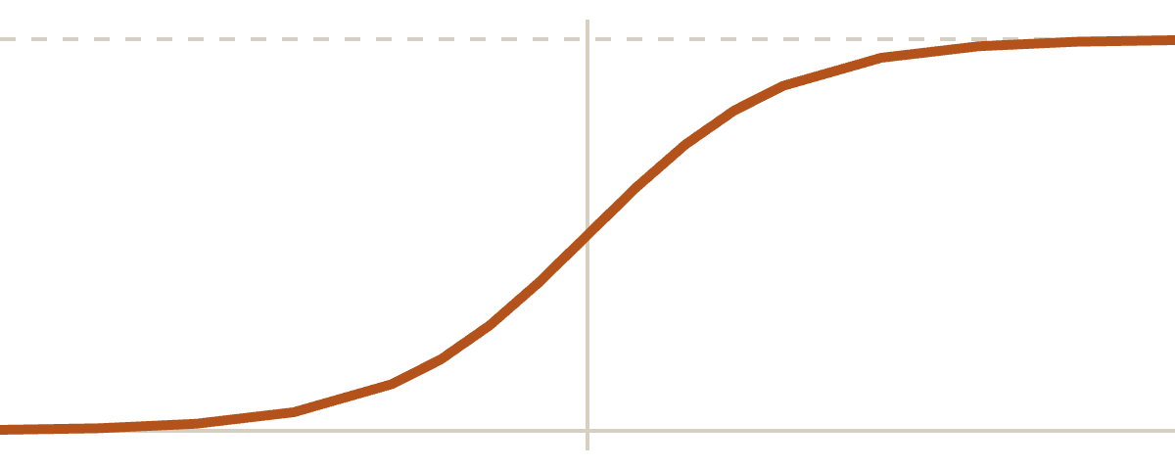
PART 1 · BUILDING BLOCK
One neuron: weigh, add, squash
y = σ(w · x + b)
# perceptron.py (trimmed)
def sigmoid(x):
return 1/(1+np.exp(-x))
class Perceptron():
def __init__(self, inputs):
self.W = np.random.random(inputs)*2 - 1
self.bias = np.random.random()*2 - 1
def forward(self, I):
y = np.dot(I, self.W) + self.bias
return sigmoid(y)
σ(z) = 1 / (1 + e^−z) squashes any number into the range 0 to 1. Read it as "how much is this a 1?"
Its slope is σ(1 − σ): backprop gets it for free from the output the neuron already computed.
Notes:
Three steps: multiply each input by its weight, add the bias, pass through the sigmoid. Weights and bias start random in [-1, 1]. Point out that the derivative of the sigmoid can be written using only its own output, which is why the training code computes output * (1 - output).

Slide 5
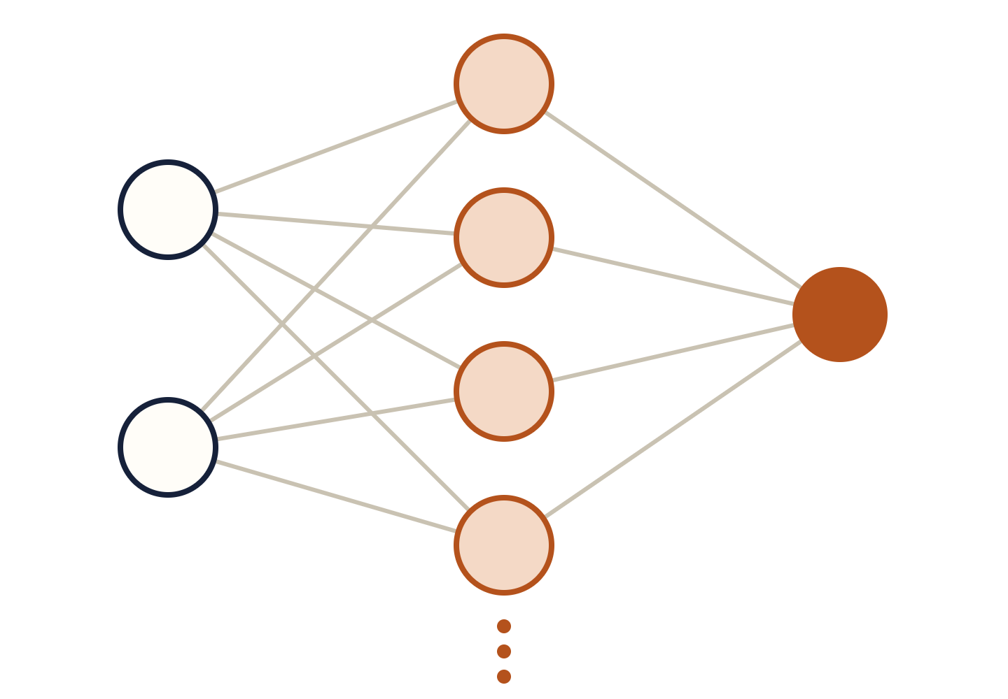
PART 1 · ARCHITECTURE
Stacking neurons into a network
# NeuralNet.forward
for i in range(self.nh):
self.hiddenOutput[i] =
self.H[i].forward(Input)
self.output = self.nO.forward(
self.hiddenOutput)
Every hidden unit is its own Perceptron, with its own weights and bias.
The output neuron treats the hidden outputs as its inputs.
train.py builds NeuralNet(2, 10).
Input
x, y
Hidden
10 units
Output
1 unit
Notes:
perceptron.py:21-44. The network is built from the Perceptron class on the previous slide: a list of hidden perceptrons, each taking the 2 inputs, and one output perceptron taking the hidden outputs. The diagram shows 4 hidden units; train.py sets the real number on line 11.

Slide 6
PART 1 · LEARNING
Backprop: send the error backward
1 · Output error
2 · Hidden errors
3 · Update
δ_out = (t − y)
· y(1 − y)
δ_i = w_i · δ_out
· h_i(1 − h_i)
w += η · input · δ
b += η · δ
How wrong the output is, scaled by the sigmoid's slope at that point.
Each hidden unit takes a share of the blame, in proportion to its weight onto the output.
Every weight moves a little in the direction that shrinks the error. η is self.lc = 0.1.
perceptron.py:51–52
perceptron.py:55–59
perceptron.py:64–74
Order matters: every δ is computed with the current weights before any weight changes.
Notes:
Walk through NeuralNet.train (perceptron.py:46-77) line by line. t is the target, y the output, h_i the hidden outputs. Step 2 uses the hidden-to-output weight w_i before step 3 changes it; that is why the code computes all errors first. The "input" in the update is whatever fed that weight: the hidden output for output-layer weights, the original input for hidden-layer weights. The bias behaves like a weight whose input is always 1.

Slide 7
PART 1 · DEMO
Training: many small nudges
What to watch
# train.py
a = pt.NeuralNet(2, 10)
for i in range(dur): # dur = 10000
for j in range(len(dataset)):
error[i] += a.train(dataset[j],
target[j])
20 networks, each from its own random starting weights
Decision surfaces: color is the output across the whole input square
Error curves: most fall toward zero, some sit on a plateau first
Same data and code, different starts, different solutions
Weights update after every single example: 10,000 passes × 4 points = 40,000 small steps.
Notes:
Run python train.py. First window: a 4x5 grid of decision surfaces, one per network. Ask: do they all carve up the square the same way? Second window: 20 error curves. Look for plateaus where the error is flat before dropping, and for any run that stays high (stuck). Good moment to talk about random initialization and local minima.

Slide 8
PART 2 · EVOLUTIONARY SEARCH
What if we skip the gradient entirely?
Encode every weight, bias and activation choice as a genome. Score it. Keep the better ones, recombine, mutate, repeat.
Notes:
Transition. Backprop needs derivatives of everything in the network. Evolution only needs a way to score a candidate. This lets us search over things that have no gradient at all, like which activation function each layer uses.

Slide 9
PART 2 · THE NETWORK
fnn.py: one network, any shape
Class | How it computes | Layers
ANNv1 | Nested for loops | 1 hidden
ANNv2 | Dot products | 1 hidden
FNN | Matrix multiply | Any number
# FNN.forward (trimmed)
def forward(self, inputs):
states = np.asarray(inputs)
for l in range(self.num_layers - 1):
z = states @ self.weights[l] + self.biases[l]
states = self.activation[l](z)
return states
FNN([2, 5, 1]) is 2 inputs, 5 hidden units, 1 output. Add numbers to the list to add layers.
Each layer uses one of 5 activations: sigmoid, tanh, ReLU, linear, Gaussian.
Same math as Part 1, a whole layer at a time. There is no train() method: something else has to set the parameters.
Notes:
fnn.py has three versions of the same idea. ANNv1 spells out every multiply with loops, good for reading. ANNv2 uses dot products. FNN (line 82) generalizes to any list of layer sizes and is what evolve.py uses. The @ here stands in for np.matmul in the real code. Emphasize: FNN cannot learn by itself; its parameters come from setParams, next slide.

Slide 10
PART 2 · ENCODING
Every parameter lives in one vector
For layers = [2, 5, 1] the genotype is 31 numbers, each in [−1, 1]. setParams() slices it into a network.
Weights · 15
Biases · 6
Activations · 10
2×5 + 5×1 = 15. Scaled ×10, then reshaped into one matrix per layer.
5 + 1 = 6. Scaled ×10.
5 genes per layer. The largest one picks that layer's function.
genesize = weights + biases + 5 × (len(layers) − 1) # evolve.py:22
Notes:
This is the genotype-to-phenotype mapping. fnn.py:102-126, setParams: walk through the vector with a start/end pointer. Weights first, layer by layer, multiplied by weightrange = 10 so genes in [-1, 1] become weights in [-10, 10]. Then biases, same scaling. Then 5 genes per layer; np.argmax picks which activation function that layer uses. This last part is something backprop could not tune, because argmax has no gradient.

Slide 11
PART 2 · SCORING
Fitness: one number per network
1.0
# evolve.py:32 (trimmed)
def fitnessFunction(genotype):
a = fnn.FNN(layers)
a.setParams(genotype)
error = 0.0
for i in range(len(dataset)):
out = a.forward(dataset[i])[0,0]
error += min(abs(out - labels[i]), 1)
return 1 - error/len(dataset)
every point exactly right
0.0
every point off by 1 or more
Error per point is capped at 1, so a ReLU or linear output that shoots off can't dominate the score.
The algorithm never looks inside the network. It only sees this number.
Notes:
The real code uses an if/else to cap each point's error at 1; min(..., 1) is the same thing. Genotype in, a number between 0 and 1 out. This function is the only link between the evolutionary algorithm and the classification task: swap the dataset and the EA does not change at all.

Slide 12

PART 2 · GENERATIONAL GA
One generation of the GA
1
2
3
4
5
Rank
Keep elite
Select
Crossover
Mutate
Sort the population by fitness.
Top 10% copied over unchanged.
Pick two parents, biased toward the top ranks.
Each gene comes from parent a or b, 50/50.
Add small Gaussian noise, clip to [−1, 1], re-score.
popsize
generations
eliteprop
recombProb
mutatStd (σ)
100
500
0.1
0.5
0.01
Notes:
eas.py:42-94, Generational.run. Step 3: np.random.triangular(0, 0, popsize) draws an index that is most likely near 0 (the best rank) and least likely near popsize, so fitter individuals become parents more often, but everyone has a chance. Step 5: every gene of every child gets Gaussian noise with standard deviation mutatStd; it is not a per-gene mutation probability. Parameters are set in evolve.py:25-30.

Slide 13
PART 2 · ALGORITHMS
Four search strategies in eas.py
Algorithm | Population | New candidates come from | Who gets replaced
HillClimber | 1 individual | Mutating that one individual | The parent, if the child is at least as fit
ParallelHillClimber | popsize separate climbers | Mutating each climber | Each parent, if its own child is at least as fit
Generational | popsize | Ranked parents, crossover, mutation | Everyone except the elite
Microbial | popsize, in local demes | Two neighbors compete; the loser copies some of the winner's genes, then mutates | Only the loser
All four share one constructor and run(), so switching is a one-word change in evolve.py:52.
Notes:
Build up in order of complexity. Hill climber: one individual, keep a mutation if it is no worse. Parallel hill climber: many independent climbers, no interaction between them. Generational: the population interacts through selection and crossover. Microbial GA (Inman Harvey): steady-state; each tournament changes only one individual, and demes restrict competition to neighbors, which helps keep diversity. Evolve.py uses Generational (highlighted).

Slide 14
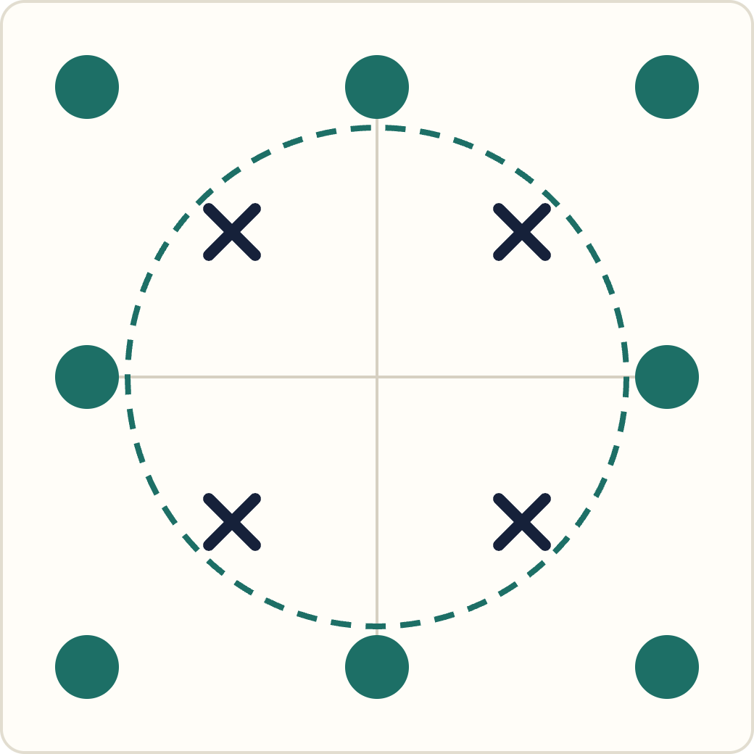
PART 2 · THE DATASET
A harder task: ring vs. center
evolve.py:15–16 swaps XOR for 12 points: the 8 on the border are 1, the 4 inside are 0.
The 1s surround the 0s, so the network needs a closed boundary, not just two parallel lines.
Ask while it runs
Which activation functions did the best network end up with?
Is the boundary a ring, a square, or something else?
Dots: target 1. Crosses: target 0. Dashed: one closed boundary that would work.
Notes:
Run python evolve.py. First window: best and average fitness over 500 generations. Second window: the decision surface of the best individual, with the 12 training points. To see which activation functions were chosen, decode the last 10 genes of bestind: np.argmax of each group of 5 (0 sigmoid, 1 tanh, 2 ReLU, 3 linear, 4 Gaussian). A Gaussian unit is a natural fit for "inside vs. outside".

Slide 15
PART 2 · DEMO
compare.py: does shape matter?
[2, 2, 1]
[2, 5, 1]
[2, 2, 2, 1]
Narrow: 2 hidden units
Wide: 5 hidden units
Deep: two hidden layers of 2
19 genes
31 genes
30 genes
red lines
blue lines
green lines
5 runs each on the ring task, best fitness per generation, all on one plot.
Which shape gets closest to 1.0?
Which is most consistent from run to run?
Deep with 30 genes or wide with 31: which wins?
Notes:
compare.py runs the Generational GA 15 times (3 shapes x 5 runs), so this takes a while; consider starting it before this slide. Before showing the plot, ask students to predict the ranking. Note that fitnessFunction reads the global layers variable, which compare.py reassigns before each block.

Slide 16
PART 3 · PYTORCH + EVOTORCH
Same ideas, library-grade tools
Part3/evolve.py rebuilds Part 2 with PyTorch for the network and EvoTorch for the evolutionary algorithm. You already know every piece.
Notes:
Message for students: the from-scratch code in Parts 1 and 2 was for understanding. Real projects use libraries, which are tested, fast, run on GPUs, and come with many algorithms. The goal of Part 3 is to recognize each piece of our own code inside the library version.

Slide 17
PART 3 · THE TRANSLATION
Your code, and its library twin
 | Part 2 (our code) | Part 3 (PyTorch / EvoTorch)
Network | fnn.FNN(layers) | XORNet(nn.Module)
Layer | weights[l], biases[l] | nn.Linear(in, out)
Genome → net | a.setParams(genotype) | vector_to_parameters(g, net.parameters())
Fitness | fitnessFunction(genotype) | Problem(objective_func=fitness_fn)
Algorithm | ea.Generational(...) | GeneticAlgorithm(problem, ...)
Crossover | uniform, recombProb | SimulatedBinaryCrossOver(...)
Mutation | Gaussian, mutatStd | GaussianMutation(stdev=...)
Elitism | eliteprop = 0.1 | elitist=True
Main loop | ga.run() | algorithm.step(), once per generation
Notes:
Walk down the table and have students call out the Part 2 equivalent before revealing it. Differences worth naming: SBX crossover blends parent values instead of copying whole genes, and parents are picked by tournament rather than by rank. Also, Part 3 fixes the activation function by command-line flag instead of evolving it.

Slide 18
PART 3 · STEP 1
The network is an nn.Module
nn.Linear(2, 3) holds a 3×2 weight matrix and 3 biases: the same numbers as wIH and bH.
Genome for hidden = 3: (2×3 + 3) + (3×1 + 1) = 13 numbers. No activation genes.
The output isn't squashed. Its sign is the answer: positive means class 1.
# Part3/evolve.py (trimmed)
class XORNet(nn.Module):
def __init__(self, hidden=3, activation="tanh"):
super().__init__()
self.net = nn.Sequential(
nn.Linear(2, hidden),
self.ACTIVATIONS[activation](),
nn.Linear(hidden, 1))
def forward(self, x):
return self.net(x)
Notes:
The real XORNet (Part3/evolve.py:19-63) loops over a list of hidden_sizes so it can stack several hidden layers; this is the single-layer case. forward() is all PyTorch needs: nn.Sequential chains the layers. Because it is a standard module, the same network could also be trained with backprop (loss.backward() and an optimizer), connecting back to Part 1. Note the inputs here are 0/1 and the targets are signs (+1/-1), unlike Part 2.

Slide 19
PART 3 · STEP 2
A Problem, then an algorithm
Problem
problem = Problem(
objective_sense="max", objective_func=fitness_fn,
solution_length=n_genes, initial_bounds=(-1, 1),
vectorized=True)
algorithm = GeneticAlgorithm(
problem, popsize=100, elitist=True,
operators=[
SimulatedBinaryCrossOver(problem, eta=20),
GaussianMutation(problem, stdev=0.5)])
for gen in range(gens):
algorithm.step()
What to optimize: genome length, starting range, and the fitness function to maximize.
vectorized=True
The fitness function gets all 100 genomes as one tensor and scores them in one shot, so it can run on a GPU.
step()
One generation. You own the loop, so you can log, plot or stop early.
Notes:
Part3/evolve.py:572-596, lightly trimmed (tournament_size=3 is also passed to the crossover). Fitness (make_fitness_fn, line 266) is the fraction of points whose output has the right sign. Instead of building one network per genome like Part 2, it slices the whole (100 x 13) population tensor into per-layer weights and uses one batched matrix multiply per layer. The run loop is at line 620 and stops early once best fitness reaches 1.0. Swapping GeneticAlgorithm for another EvoTorch algorithm (such as CMAES or SNES) reuses the same Problem.

Slide 20
PART 3 · DEMO
Run it: experiments are flags
Also try
# XOR, with fitness plot and decision boundary
python evolve.py --vizperf --vizbound
# Can one hidden unit solve XOR?
python evolve.py --hidden 1 --vizbound
# Two hidden layers, 8 points on a circle
python evolve.py --hidden_sizes 4 4 --convex 8 --vizbound
# Mutation only: does crossover help?
python evolve.py --no-crossover --verbose
--task and, or, xnor
--activation relu
--random 10
--seed 1 for repeatable runs
--device cuda or mps
python evolve.py --help
Notes:
Run from Part3/. Plain XOR usually converges within a few generations, which is itself worth discussing next to Part 2. The --hidden 1 run is a nice prediction exercise: one tanh unit followed by a linear output still draws a single straight boundary. --fitness_mode mse raises NotImplementedError on purpose: it is the TODO in make_fitness_fn (line 356), left as an exercise.

Slide 21
WRAP-UP
Backprop vs. evolution
 | Backprop (Part 1) | Evolution (Part 2)
Needs | A differentiable network and error | Only a fitness score
Tunes | Weights and biases | Weights, biases and activation functions
Moves by | Following the gradient, one example at a time | Variation and selection across a population
Cost per step | One forward and one backward pass | popsize fitness evaluations per generation
Gets stuck when | Plateaus, flat sigmoids, unlucky starting weights | Diversity runs out, or mutation is too small or too large
Notes:
Neither method is universally better. Backprop is far more efficient when you have gradients, which is why it dominates deep learning. Evolution is useful when you do not: discrete choices (like the activation function), non-differentiable fitness, or tasks where you can only score whole behaviors, like a robot controller.

Slide 22
YOUR TURN
Try it yourself
PART 1 · BACKPROP
PART 2 · EVOLUTION
Use 2 hidden units (train.py:11). How many of the 20 networks still solve XOR?
Set self.lc to 0.01, then 1.0 (perceptron.py:34). What happens to the error curves?
Train on AND: target = [0, 0, 0, 1]. Is a hidden layer still needed?
Swap ea.Generational for ea.Microbial or ea.HillClimber (evolve.py:52).
Raise mutatStd from 0.01 to 0.1. Faster progress, or just noise?
Comment out evolve.py:15–16 to go back to XOR. How quickly is it solved?
Notes:
All of these are one-line changes. Encourage students to predict before they run. For the Part 2 swap, evolve.py already passes every keyword argument the other algorithms need (popsize, recombProb, mutatStd, demeSize), so only the class name changes.

